Slide 1


HVS​
Concept of OBC Management

Slide 2

Contents
Electronic lock control and diagnosis
S2 control and diagnosis
OBC status control and diagnosis
AC Charge parameters management

Slide 3
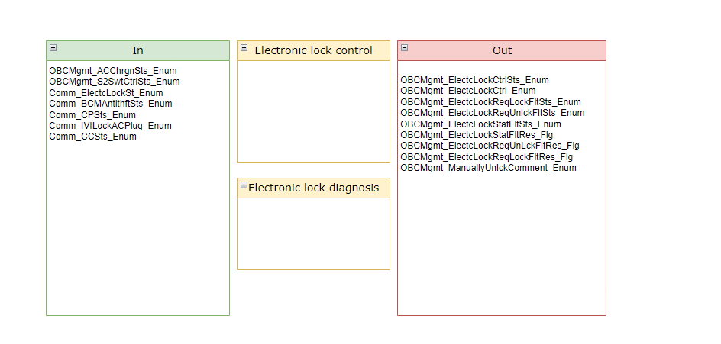
Electronic lock control and diagnosis
Electronic lock control and diagnosis

Slide 4
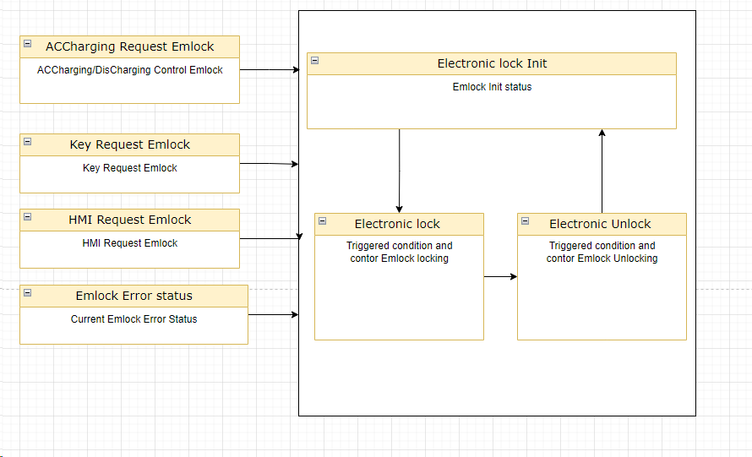
Electronic lock control and diagnosis
Electronic lock control

Slide 5
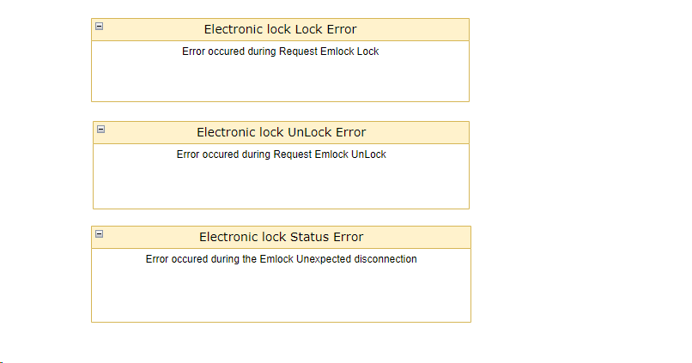
Electronic lock control and diagnosis
Electronic lock diagnosis

Slide 6
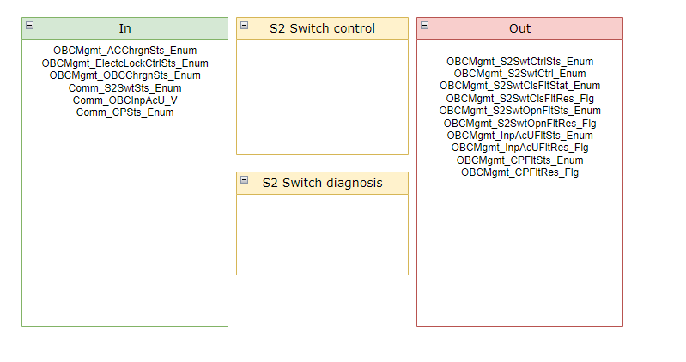
S2 control and diagnosis

Slide 7
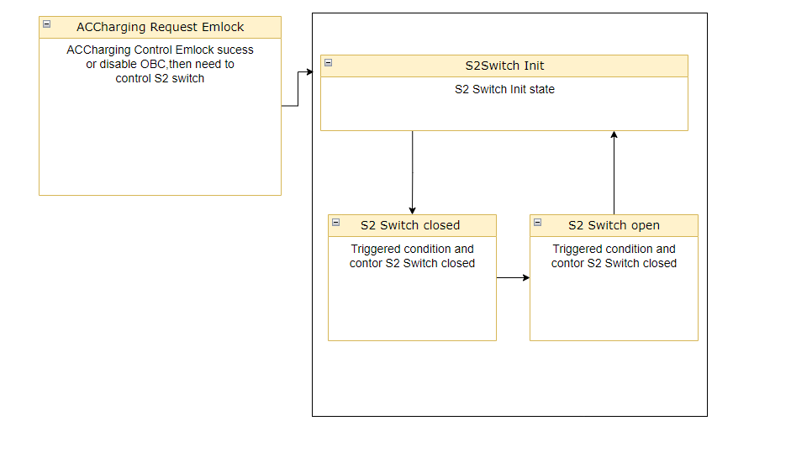
S2 control and diagnosis
S2 control

Slide 8
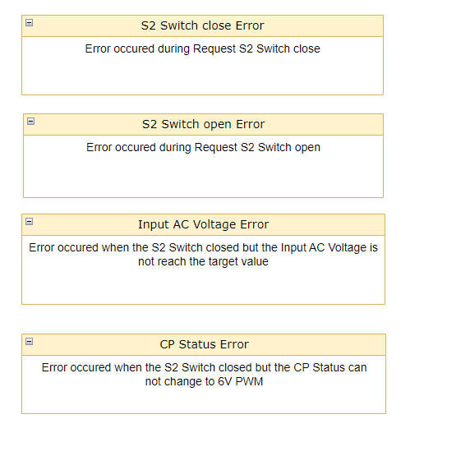
S2 control and diagnosis
S2 diagnosis

Slide 9
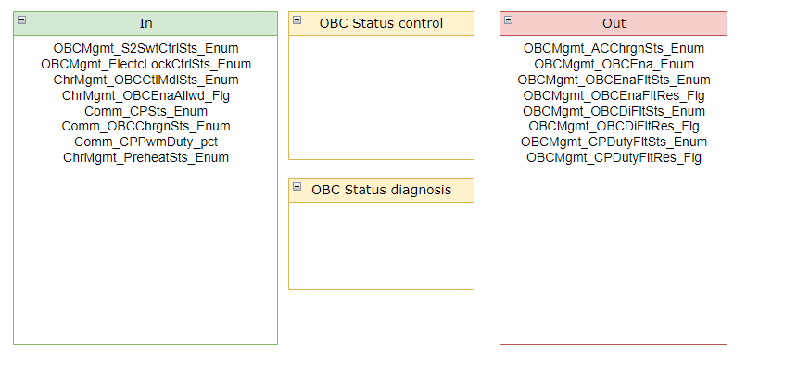
OBC Status control and diagnosis

Slide 10
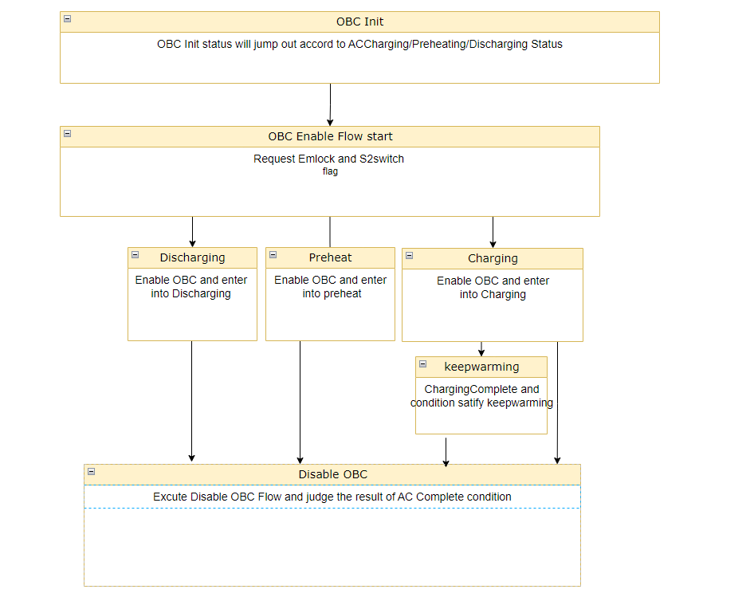
OBC Status control and diagnosis
OBC Status control

Slide 11
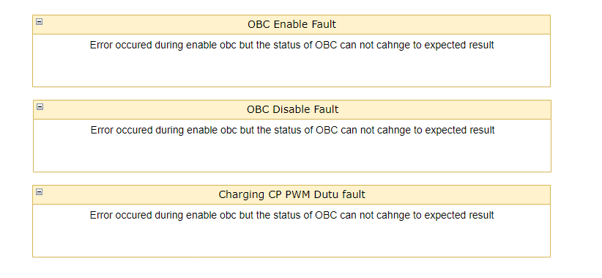
OBC Status control and diagnosis
OBC Status diagnosis

Slide 12
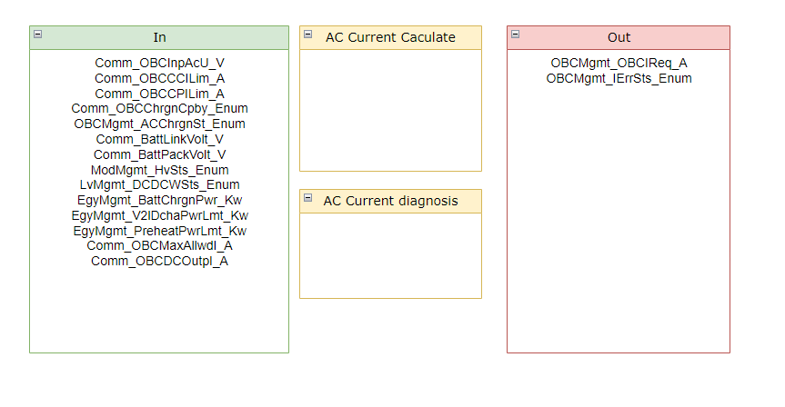
AC Charge parameters management

Slide 13
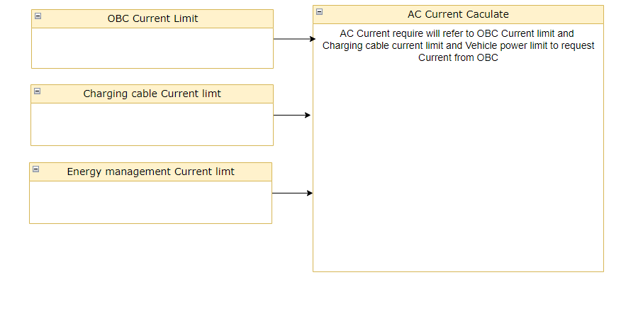
AC Charge parameters management
AC Charge parameter caculate

Slide 14
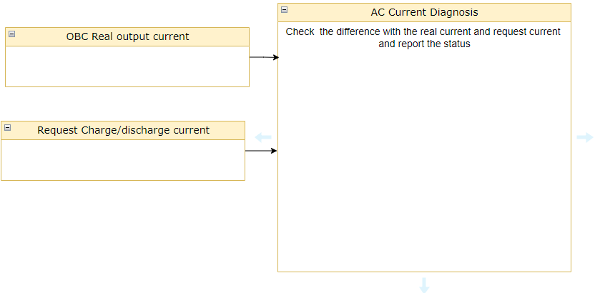
AC Charge parameters management
AC Charge parameter diagnosis

Slide 15
Backup

